Slide 1
Web scraping to gain company insights
Scrape and analyse customer review data to uncover findings for British Airways
Lívia de Souza Simões
Data Scientist | PhD Engineering | Machine Learning | Python

Slide 2
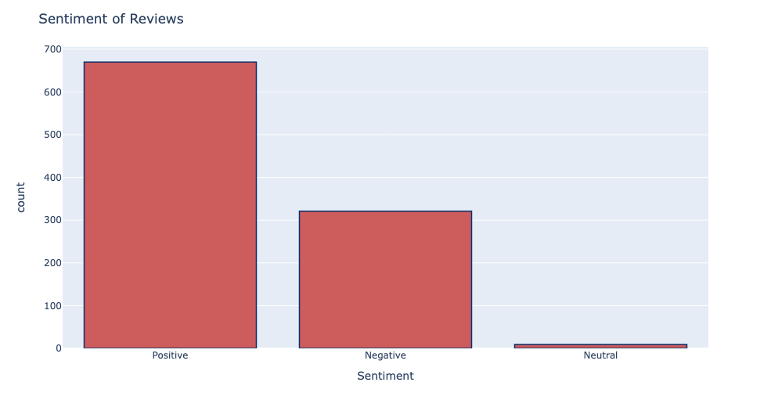
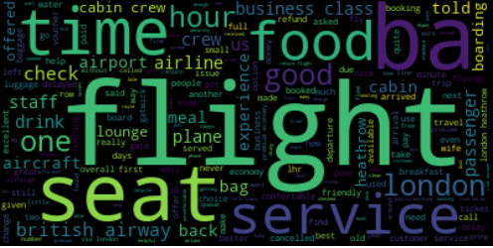
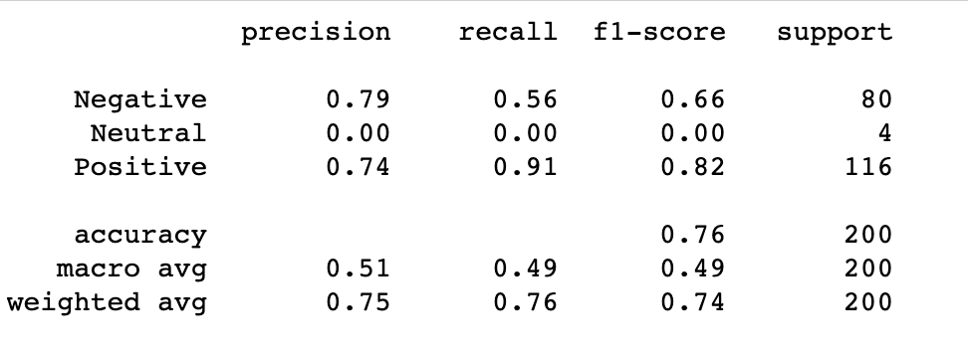
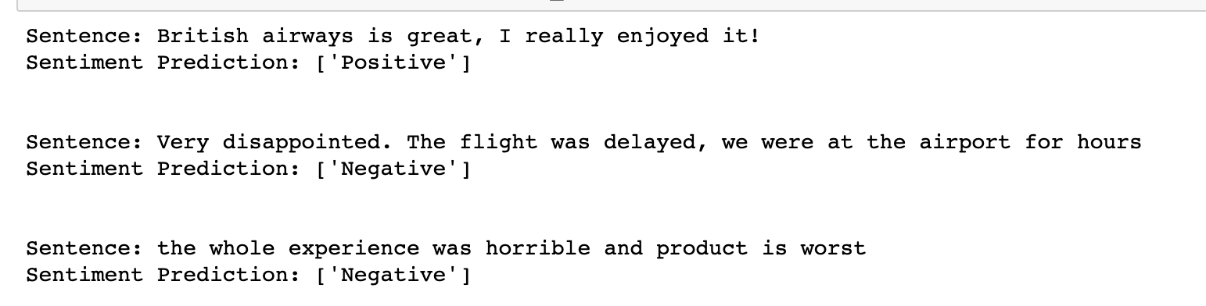
Wordcloud
Sentiment of reviews
Some popular words that can be observed here include “flight”, “service”, “time” and “food. These words are mostly positive, also indicating that most reviews in the dataset express a positive sentiment.
As we can see data is unbalanced so this will create problem for model but, will take this data as it is and will predict our reviews
Building Regression Logistic Model
Classification report
Test sentences
Logistic Regression Accuracy: 75.50%

